Slide 1
Lecture 2
Foundations of Data Mining

Slide 2
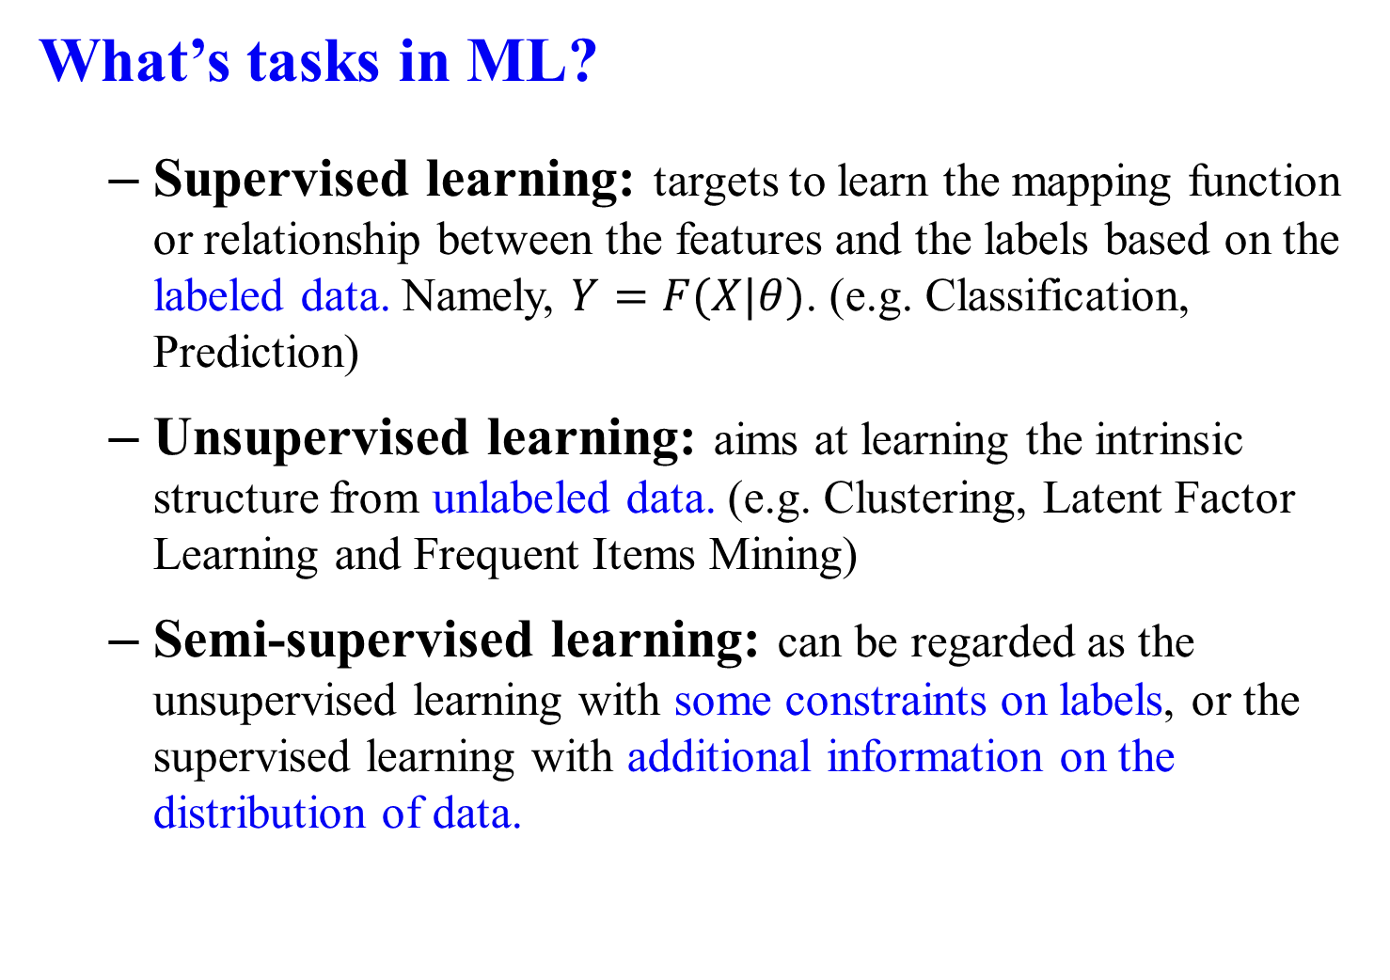
What’s tasks in ML?
Supervised learning: targets to learn the mapping function or relationship between the features and the labels based on the labeled data. Namely, $Y=F(X|θ)$. (e.g. Classification, Prediction)
Unsupervised learning: aims at learning the intrinsic structure from unlabeled data. (e.g. Clustering, Latent Factor Learning and Frequent Items Mining)
Semi-supervised learning: can be regarded as the unsupervised learning with some constraints on labels, or the supervised learning with additional information on the distribution of data.
Classification-Clustering- Association Rule Mining- Outlier Detection

Slide 3
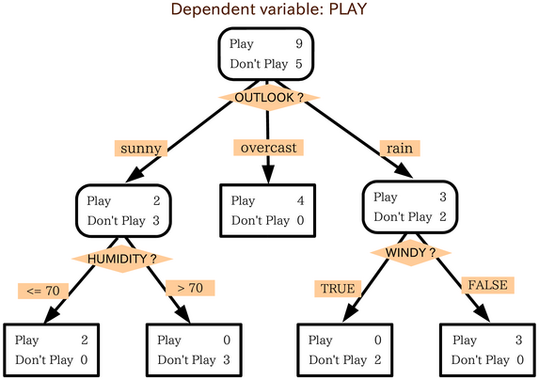
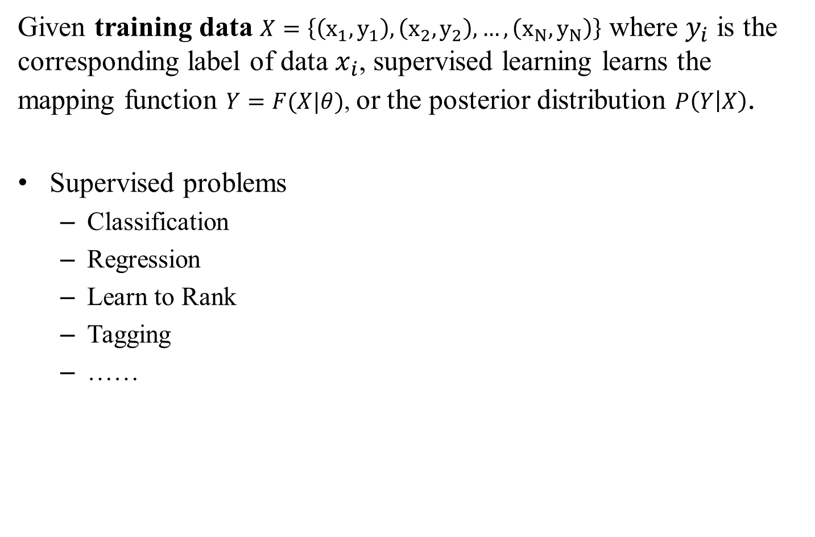
Supervised Learning
Given training data $X=\left\{\left(x_{1}, y_{1}\right),\left(x_{2},y_{2}\right),…,\left(x_{N},y_{N}\right)\right\}$ where $y_{i}$ is the corresponding label of data $x_{i}$, supervised learning learns the mapping function $Y=F(X|θ)$, or the posterior distribution $P\left(Y | X\right)$.
Supervised problems
Classification
Regression
Learn to Rank
Tagging
……

Slide 4
Example: Payment Prediction Revisit
Find the mapping function or model to answer whether one’s salary is more than 50k.
Age | Edu. year | HoursPerWeek | Pay
25 | 7 | 40 | <50k
38 | 9 | 50 | ≥50k
28 | 12 | 40 | ≥50k
24 | 10 | 40 | <50k
55 | 4 | 10 | ?

Slide 5
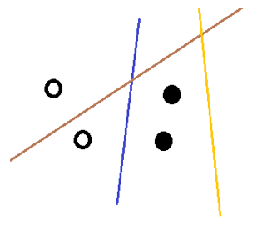
If the solid points represent “salary < 50k” and hollow ones for “≥50k”, we can use the line to separate those points
Which one is better?
Blue one
Why? → minimum error on predicted result (separate results)
A good model should minimize the loss on training data

Slide 6
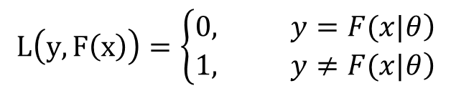
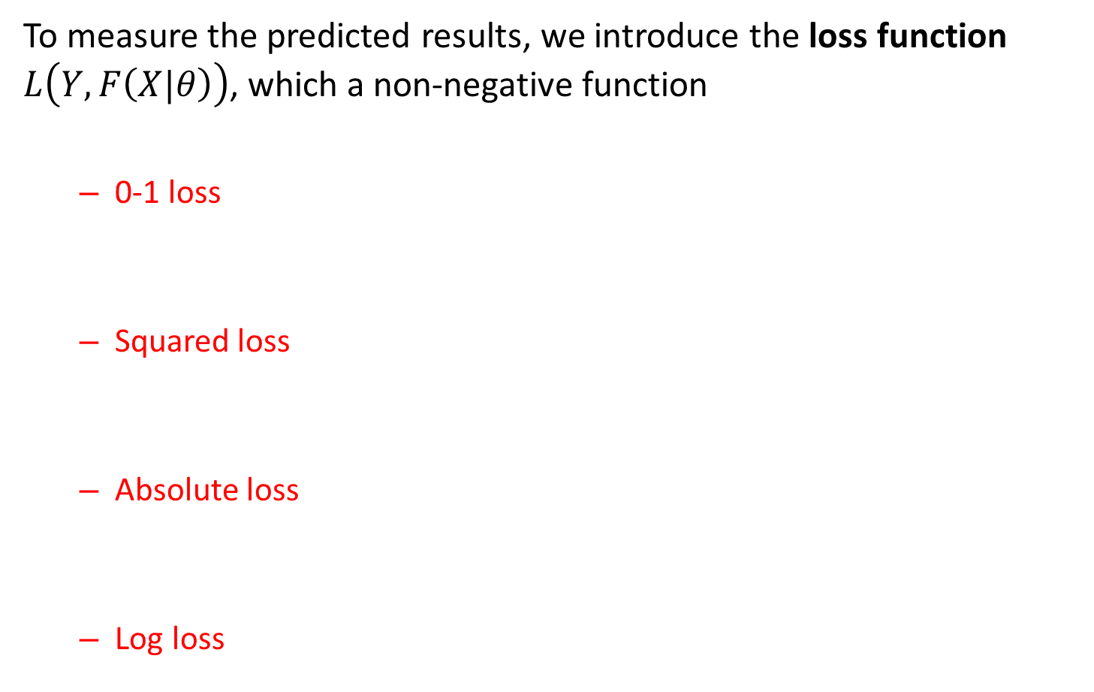
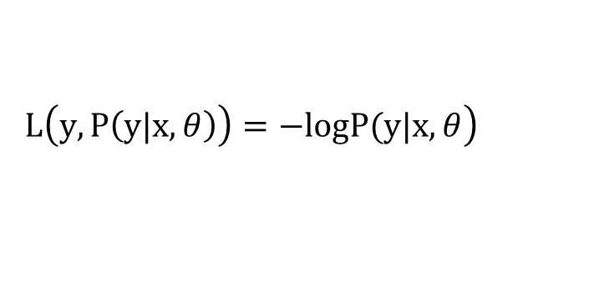
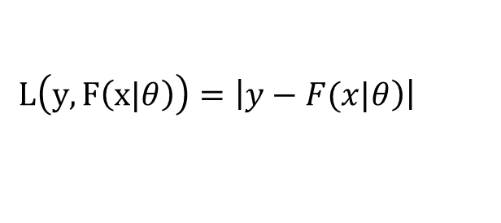
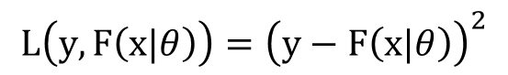
LOSS FUNCTION
To measure the predicted results, we introduce the loss function $L\left(Y,F\left(X|θ\right)\right)$, which a non-negative function
0-1 loss
Squared loss
Absolute loss
Log loss
$$L\left(y,F\left(x\right)\right)=\left\{\begin{aligned}&\left.0, y=F(x|θ\right) \\ &\left.1, y≠F(x|θ\right)\end{aligned}\right.$$
$$L\left(y,F\left(x|θ\right)\right)={\left(y−F\left(x|θ\right)\right)}^{2}$$
$$L\left(y,F\left(x|θ\right)\right)=\left|\left.y−F(x|θ\right)\right|$$
$$\left.L\left(y,P\left(y|x,θ\right)\right)=−logP(y|x,θ\right)$$

Slide 7
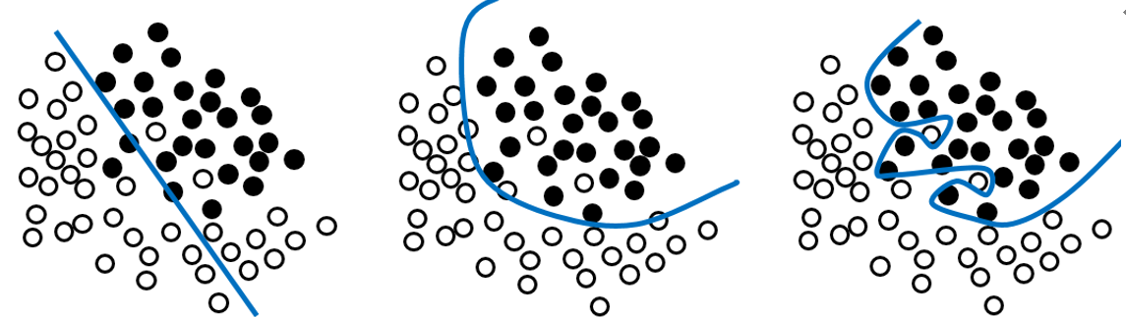
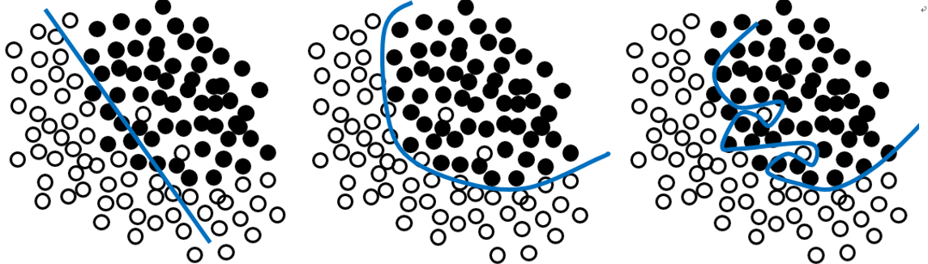
Training Loss and Test Loss
Training loss: loss on training data Test loss: loss on test data
Performance on training data of three models
Performance on training data and test data
Who wins?

Slide 8
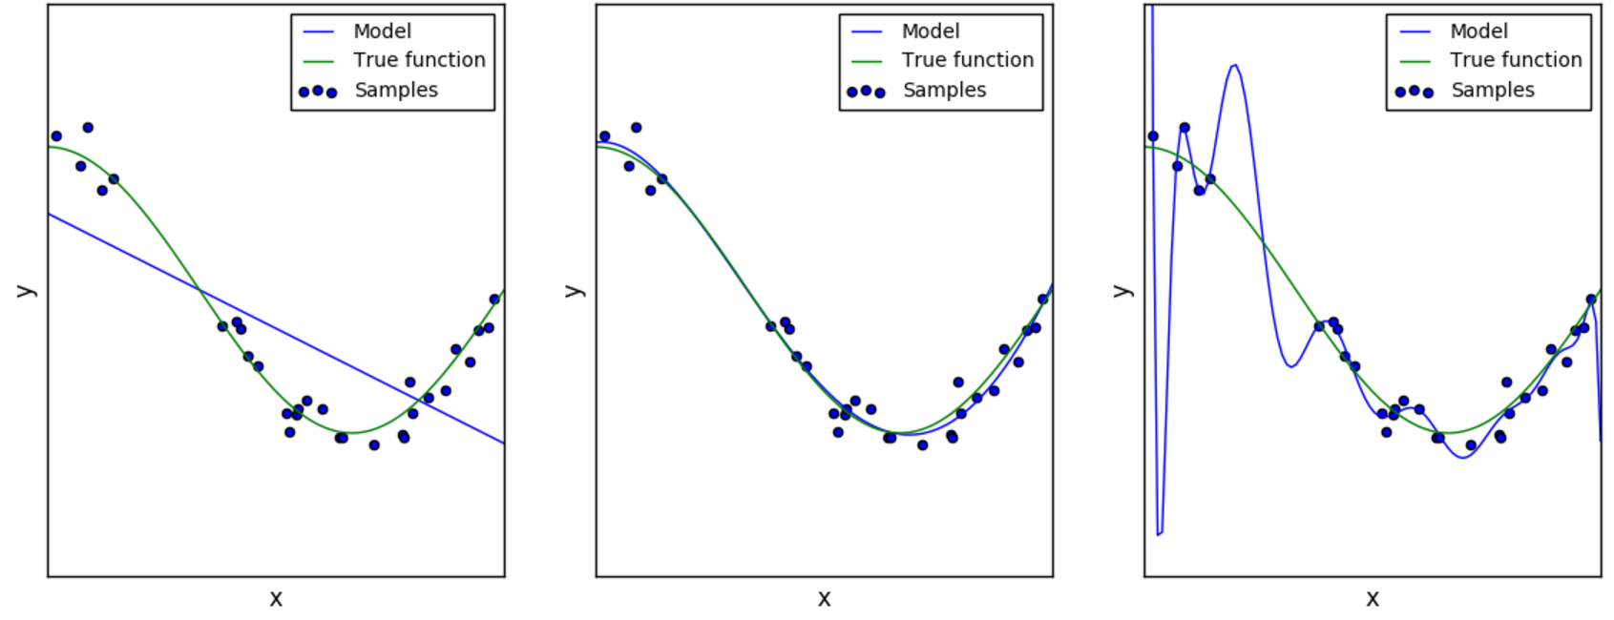
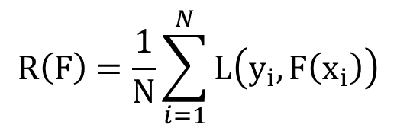
Generalization
Empirical risk:
Note: A good model cannot only take training loss into account and minimize the empirical risk. Instead, improve the model generalization.
$$R\left(F\right)=\frac{1}{N}\sum_{i=1}^{N}{L\left(y_{i},F\left(x_{i}\right)\right)}$$
Model Selection:
To avoid Underfitting and Overfitting

Slide 9
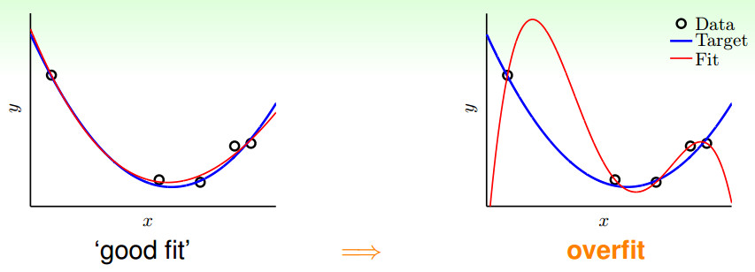
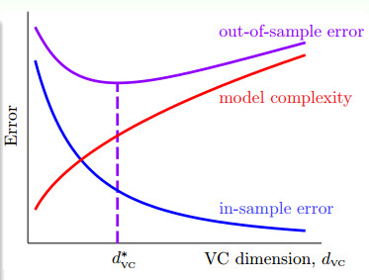
Strategy
Increase Sample
Remove Outliers
Decrease model complexity
Train-Validation-Test
Regularization
Source：http://jasonding1354.github.io/

Slide 10
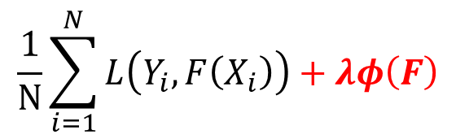
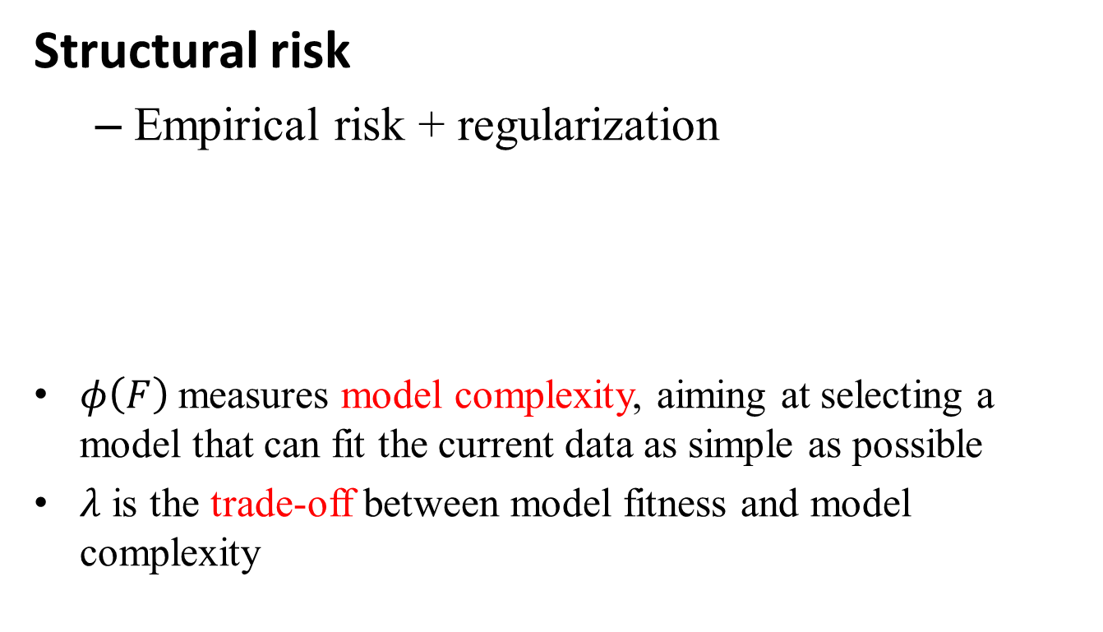
Model Selection and Regularization
Structural risk
Empirical risk + regularization
$φ\left(F\right)$measures model complexity, aiming at selecting a model that can fit the current data as simple as possible
$λ$ is the trade-off between model fitness and model complexity
$$\frac{1}{N}\sum_{i=1}^{N}{L\left(Y_{i},F\left(X_{i}\right)\right)+λφ\left(F\right)}$$

Slide 11
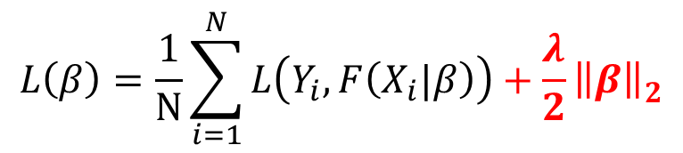
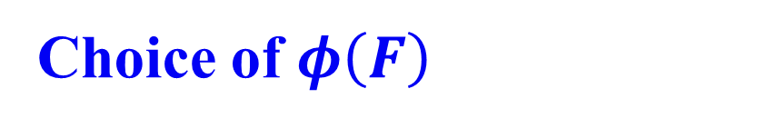
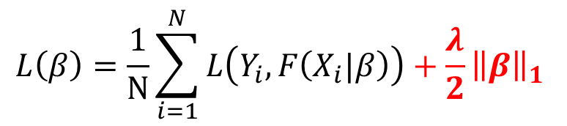
Choice of $φ\left(F\right)$
L₂ norm:
L₁ norm:
L_{p} norm, nuclear norm…
$$L\left(β\right)=\frac{1}{N}\sum_{i=1}^{N}{L\left(Y_{i},F\left(X_{i}|β\right)\right)+\frac{λ}{2}{\left\|β\right\|}_{2}^{ }}$$
$$L\left(β\right)=\frac{1}{N}\sum_{i=1}^{N}{L\left(Y_{i},F\left(X_{i}|β\right)\right)+\frac{λ}{2}{{\left\|β\right\|}_{1}}^{ }}$$

Slide 12
Classification vs. Regression
Classification
predicts categorical class labels (discrete or nominal)
classifies data (constructs a model) based on the training set and the values (class labels) in a classifying attribute and uses it in classifying new data
Regression
models continuous-valued functions, i.e., predicts unknown or missing values
Typical applications
Credit approval
Target marketing
Medical diagnosis
Fraud detection

Slide 13
Classification

Slide 14
Classification—A Two-Step Process
Model construction: describing a set of predetermined classes
Each tuple/sample is assumed to belong to a predefined class, as determined by the class label attribute
The set of tuples used for model construction is training set
The model is represented as classification rules, decision trees, or mathematical formulae
Model usage: for classifying future or unknown objects
Estimate accuracy of the model
The known label of test sample is compared with the classified result from the model
Accuracy rate is the percentage of test set samples that are correctly classified by the model
Test set is independent of training set, otherwise over-fitting will occur
If the accuracy is acceptable, use the model to classify data tuples whose class labels are not known

Slide 15
1. Nearest Neighbor Classifiers
Basic idea: If it walks like a duck, quacks like a duck, then it’s probably a duck
Compute Distance
Test Record
Training Records
Choose k of the “nearest” records

Slide 16
Definition of Nearest Neighbor
K-nearest neighbors of a record x are data points that have the k smallest distance to x

Slide 17
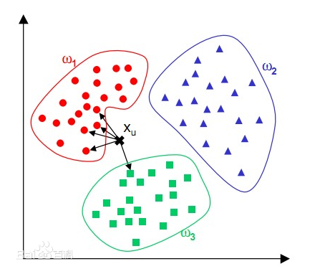
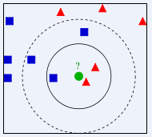
Predict class label of test instance with major vote strategy
KNN classifier
The effect of K

Slide 18
Remarks
Highly effective method for noisy training data
Target function for a whole space may be described as a combination of less complex local approximations
Learning is very simple (lazy learning)
Classification is time consuming
Difficult to determine the optimal k
Curse of Dimensionality

Slide 19
2. Naïve Bayes
Given training data X, posteriori probability of a hypothesis H, P(H|X), follows the Bayes theorem
Predicts X belongs to C₂ iff the probability P(C₂|X) is the highest among all the P(C_{k}|X) for all the k classes
Practical difficulty: require initial knowledge of many probabilities, significant computational cost

Slide 20
Class Conditional independent

Slide 21
Case Study
Spam Email Problem: classifying documents by their content: whether a document is a spam email or a non-spam email?
Namely, what is the probability that a given document D belongs to a given class C?“ In other words, what is ?
For spam email investigation, by Bayes' theorem, we have
where S means class of spam email and S^{c} is the class of normal email.

Slide 22
The problem is transferred to determine which posterior probability is much higher?
Since is a constant and is not relevant to S_{j} , the equation can be further written as:
The most common format
Given a document D, we can then use this formulas to determine whether it is a spam email or not.

Slide 23
To compute the posterior probability, we must first compute the prior probability and the conditional probability
Suppose we have already known the class information (spam or non-spam) of some emails (which are called as “training data”).
The can be easily obtained to compute based on the training data.
For , it can be computed as follows. As each document can be modelled as sets of words, the probability that a given document occurs in a document from class S_{j} can be written as

Slide 24
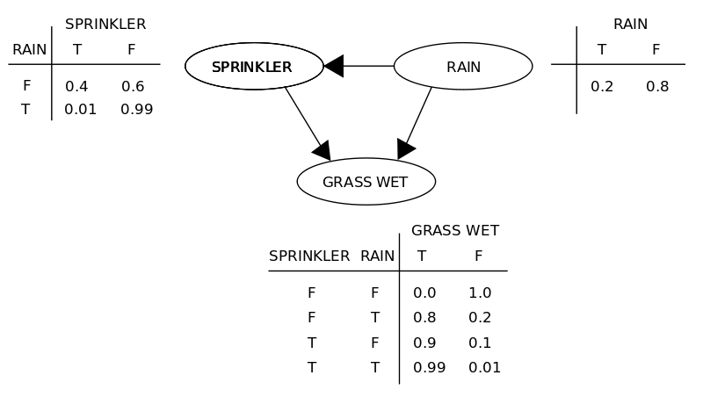
Independence Assumption
1、Naïve Bayes Classifier
2、Bayesian Network (without independence assumption)

Slide 25
Example of a Decision Tree
3. Decision Tree
categorical
categorical
continuous
class
Splitting Attributes
Refund
Yes
No
NO
MarSt
Single, Divorced
Married
TaxInc
NO
< 80K
> 80K
NO
YES
Training Data
Model: Decision Tree

Slide 26
Decision Tree Classification Task
Decision Tree

Slide 27
Apply Model to Test Data
Test Data
Start from the root of tree.
Refund
Yes
No
NO
MarSt
Single, Divorced
Married
TaxInc
NO
< 80K
> 80K
NO
YES

Slide 28
Apply Model to Test Data
Test Data
Refund
Yes
No
NO
MarSt
Single, Divorced
Married
TaxInc
NO
< 80K
> 80K
NO
YES

Slide 29
Apply Model to Test Data
Test Data
Refund
Yes
No
NO
MarSt
Single, Divorced
Married
TaxInc
NO
< 80K
> 80K
NO
YES

Slide 30
Apply Model to Test Data
Test Data
Refund
Yes
No
NO
MarSt
Single, Divorced
Married
TaxInc
NO
< 80K
> 80K
NO
YES

Slide 31
Apply Model to Test Data
Test Data
Refund
Yes
No
NO
MarSt
Single, Divorced
Married
TaxInc
NO
< 80K
> 80K
NO
YES

Slide 32
Apply Model to Test Data
Test Data
Refund
Yes
No
NO
MarSt
Single, Divorced
Married
Assign Cheat to “No”
TaxInc
NO
< 80K
> 80K
NO
YES

Slide 33
How to determine the Best Split
Before Splitting: 10 records of class 0, 10 records of class 1
Which test condition is the best?
Gini Index Entropy

Slide 34
Information Gain

Slide 35
Attribute Selection: Information Gain
Class P: buys_computer = “yes”
Class N: buys_computer = “no”
means “age <=30” has 5 out of 14 samples, with 2 yes’es and 3 no’s. Hence
Similarly,

Slide 36
4. SVM
General Philosophy
Small Margin
Large Margin
Support Vectors

Slide 37
SVM—When Data Is Linearly Separable
m
Let data D be (X₁, y₁), …, (X_{|D|}, y_{|D|}), where X_{i} is the set of training tuples associated with the class labels y_{i}
There are infinite lines (hyperplanes) separating the two classes but we want to find the best one (the one that minimizes classification error on unseen data)
SVM searches for the hyperplane with the largest margin, i.e., maximum marginal hyperplane (MMH)

Slide 38
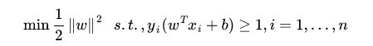
SVM—Linearly Separable
A separating hyperplane can be written as
W · X + b = 0
where W={w₁, w₂, …, w_{n}} is a weight vector and b a scalar (bias)
The hyperplane defining the sides of the margin:
H₁: w₀ + w₁ x₁ + w₂ x₂ ≥ 1 for y_{i} = +1, and
H₂: w₀ + w₁ x₁ + w₂ x₂ ≤ – 1 for y_{i} = –1
Any training tuples that fall on hyperplanes H₁ or H₂ (i.e., the sides defining the margin) are support vectors
This becomes a constrained (convex) quadratic optimization problem: Quadratic objective function and linear constraints → Quadratic Programming (QP) → Lagrangian multipliers

Slide 39
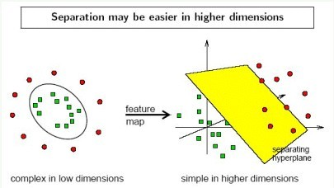
SVM—Linearly Inseparable
Transform the original input data into a higher dimensional space
Search for a linear separating hyperplane in the new space

Slide 40
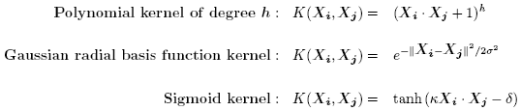
SVM—Kernel functions
Instead of computing the dot product on the transformed data tuples, it is mathematically equivalent to instead applying a kernel function K(X_{i}, X_{j}) to the original data, i.e., K(X_{i}, X_{j}) = Φ(X_{i}) Φ(X_{j})
Typical Kernel Functions

Slide 41
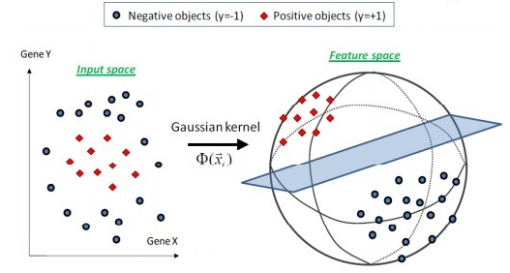

Slide 42
Ensemble Learning
Criteria: Good performance + Diversity
Strategies:
Bagging
Boosting
Stacking

Slide 43
Rationale for Ensemble Learning
No Free Lunch thm: There is no algorithm that is always the most accurate
Generate a group of base-learners which when combined have higher accuracy
Different learners use different
Algorithms
Parameters
Representations (Modalities)
Training sets
Subproblems

Slide 44
1. Bagging - Aggregate Bootstrapping
Given a standard training set D of size n
For i = 1 .. M
Draw a sample of size n*<n from D uniformly and with replacement
Learn classifier C_{i}
Final classifier is a vote of C₁ .. C_{M}
Increases classifier stability/reduces variance

Slide 45
Random Forest
Ensemble consisting of a bagging of un-pruned
decision tree learners with a randomized selection of
features at each split.
Grow many trees on datasets sampled from the original dataset with replacement (a bootstrap sample).
Draw K bootstrap samples of a fixed size
Grow a DT, randomly sampling a few attributes/dimensions to split on at each internal node
Average the predictions of the trees for a new query (or take majority vote)
Random Forests are state of the art classifiers!

Slide 46
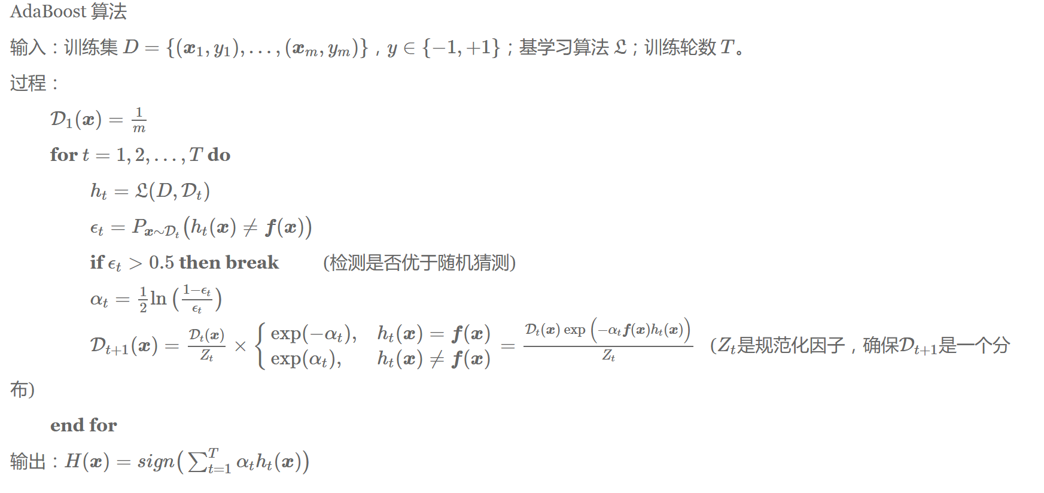
Boosting

Slide 47
2.Boosting
Train classifiers (e.g. decision trees) in a sequence.
A new classifier should focus on those cases which were incorrectly classified in the last round.
Combine the classifiers by letting them vote on the final prediction (like bagging).
Each classifier is “weak” but the ensemble is “strong.”
AdaBoost is a specific boosting method.

Slide 48
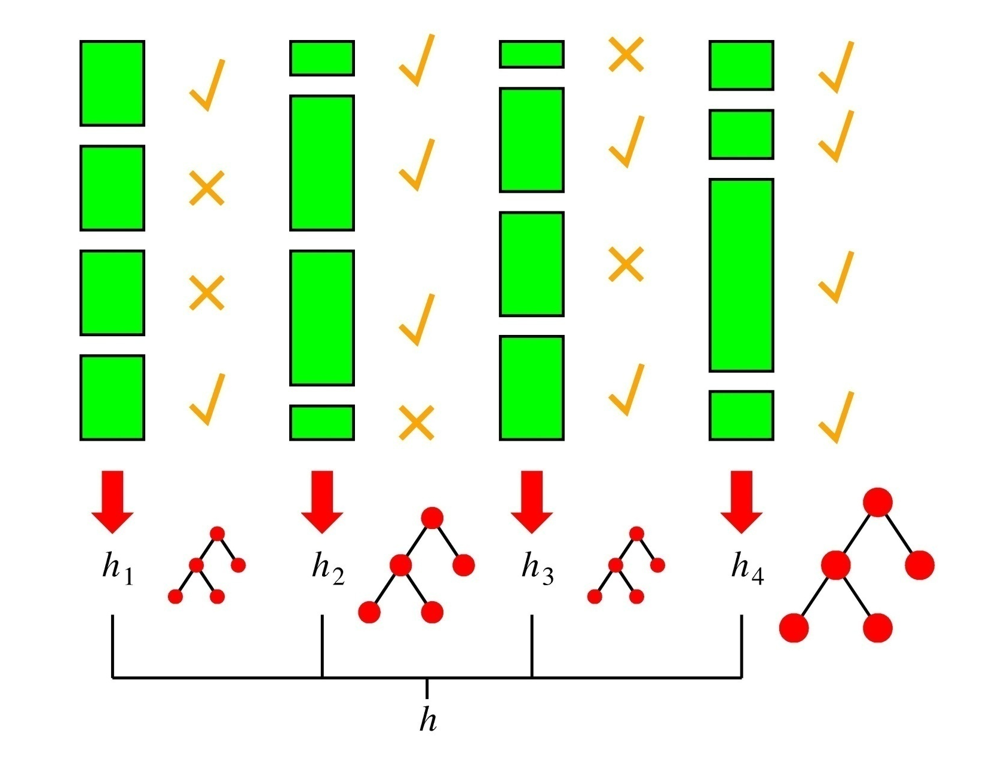
Boosting in a Picture
boosting rounds
training cases
Correctly
classified
This example
has a large weight
in this round
This DT has
a strong vote.

Slide 49
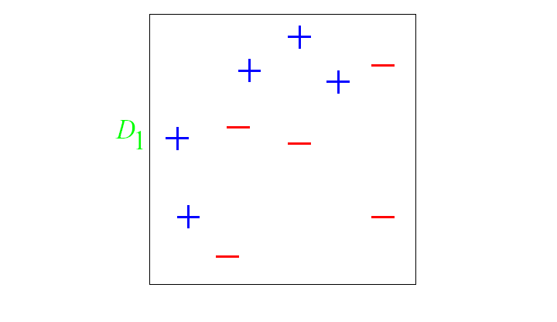
And in animation
Original training set: equal weights to all training samples
Taken from “A Tutorial on Boosting” by Yoav Freund and Rob Schapire

Slide 50
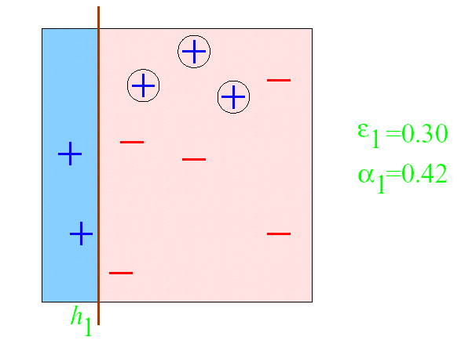
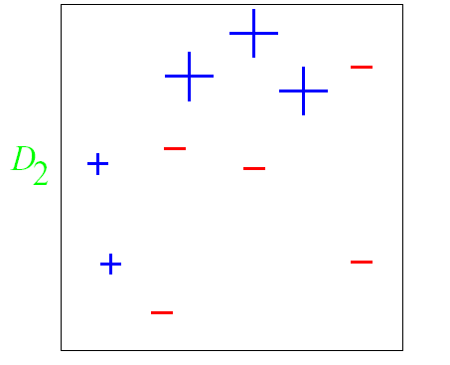
AdaBoost example
ε = error rate of classifier
α = weight of classifier
ROUND 1

Slide 51
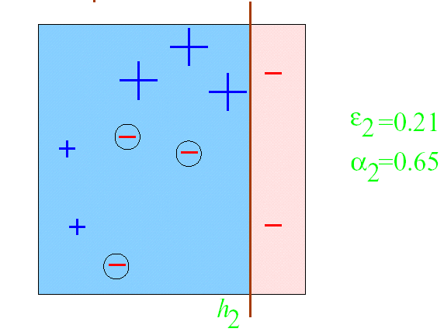
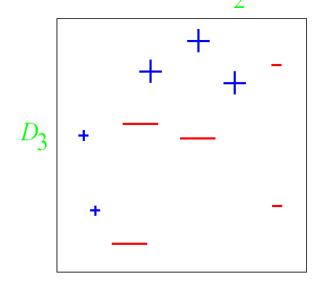
AdaBoost example
ROUND 2

Slide 52
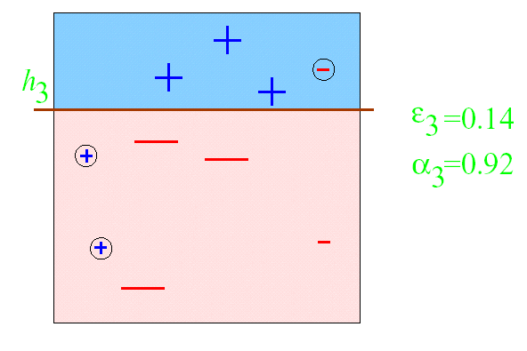
AdaBoost example
ROUND 3

Slide 53
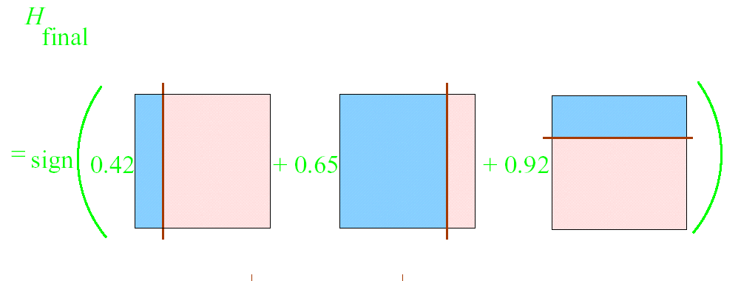
AdaBoost example

Slide 54
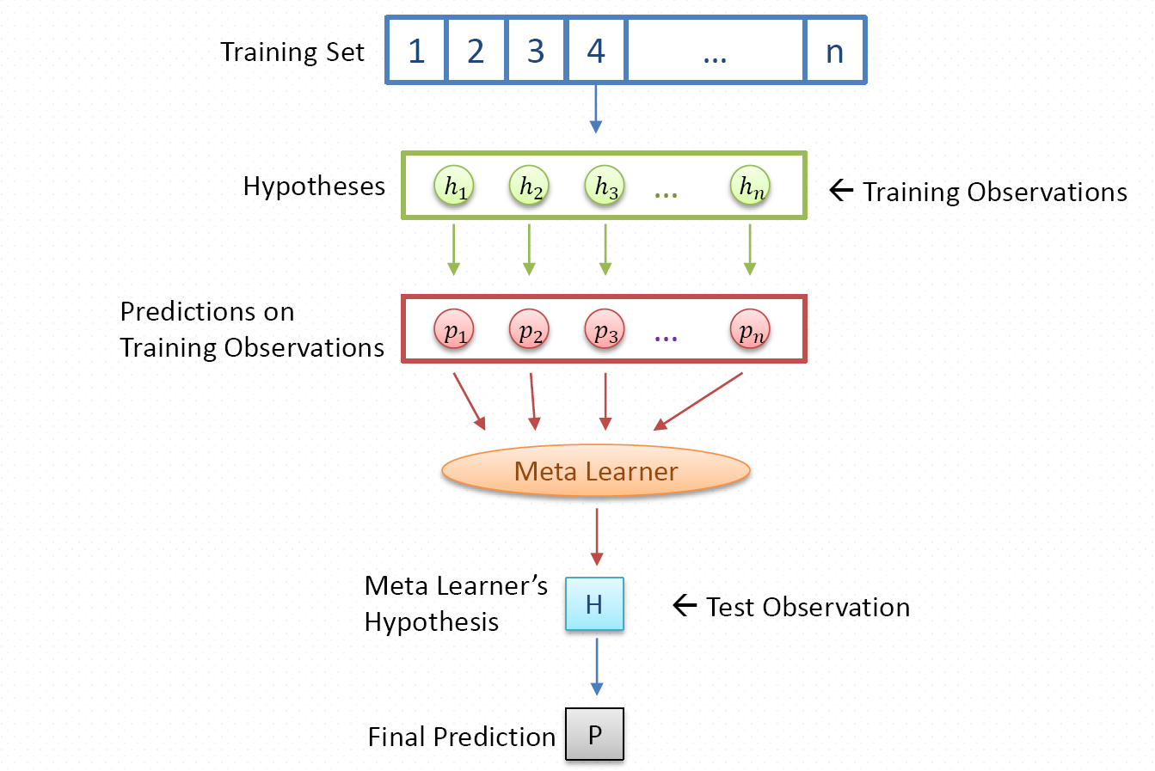
3. Stacking
Framework

Slide 55
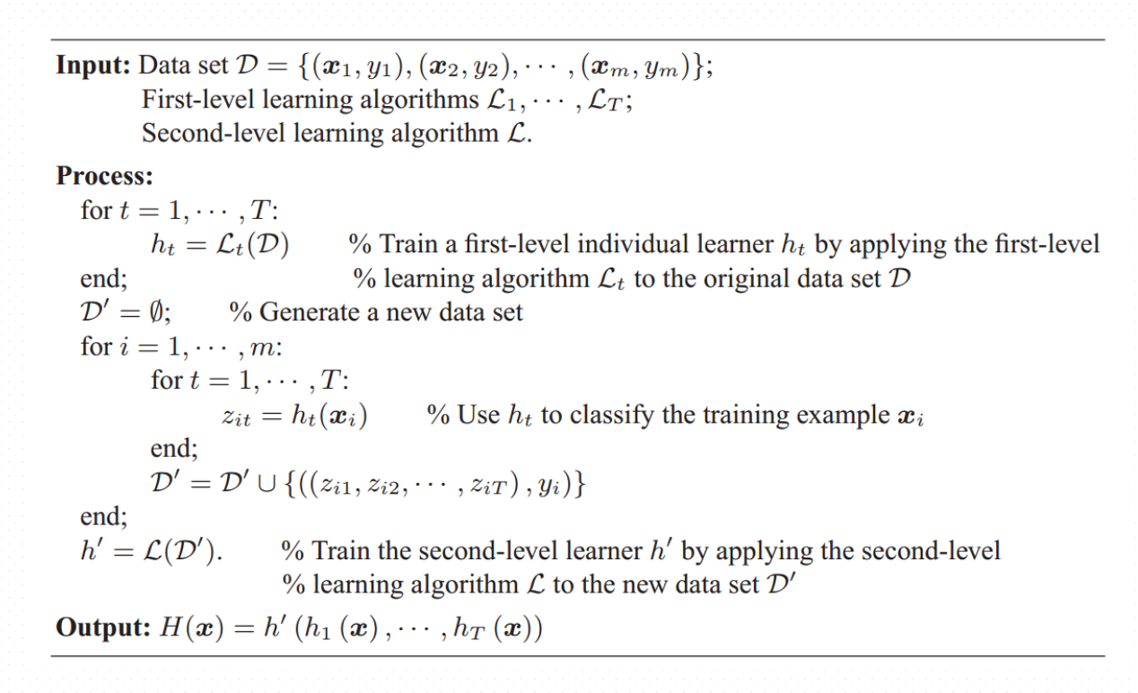
Stacking

Slide 56
Clustering

Slide 57
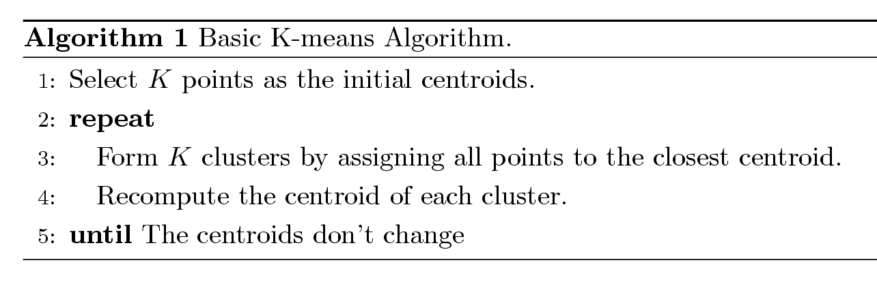
1. K-means Clustering
Partitional clustering approach
Each cluster is associated with a centroid (center point)
Each point is assigned to the cluster with the closest centroid
Number of clusters, K, must be specified
The basic algorithm is very simple

Slide 58
Two different K-means Clusterings
Original Points
Optimal Clustering
Sub-optimal Clustering

Slide 59
Importance of Choosing Initial Centroids …

Slide 60
Importance of Choosing Initial Centroids …

Slide 61
Solutions to Initial Centroids Problem
Multiple runs
Helps, but probability is not on your side
Sample and use hierarchical clustering to determine initial centroids
Select more than k initial centroids and then select among these initial centroids
Select most widely separated

Slide 62
Evaluating K-means Clusters
Most common measure is Sum of Squared Error (SSE)
For each point, the error is the distance to the nearest cluster
To get SSE, we square these errors and sum them.
x is a data point in cluster C_{i} and m_{i} is the representative point for cluster C_{i} (can show that m_{i} corresponds to the center (mean) of the cluster)
Given two clusters, we can choose the one with the smallest error
One easy way to reduce SSE is to increase K (the number of cluster)
A good clustering with smaller K can have a lower SSE than a poor clustering with higher K

Slide 63
What Is the Problem of the K-Means Method?
Problem: The k-means algorithm is sensitive to outliers !
K-Medoids: Instead of taking the mean value of the object in a cluster as a reference point, medoids can be used, which is the most centrally located object in a cluster.
10
10
9
9
8
8
7
7
6
6
5
5
4
4
3
3
2
2
1
1
0
0
1
2
3
4
5
6
7
8
9
10
0
0
1
2
3
4
5
6
7
8
9
10

Slide 64
The K-Medoids Clustering Method
Find representative objects, called medoids, in clusters
PAM (Partitioning Around Medoids, 1987)
starts from an initial set of medoids and iteratively replaces one of the medoids by one of the non-medoids if it improves the total distance of the resulting clustering
PAM works effectively for small data sets, but does not scale well for large data sets
CLARA (Kaufmann & Rousseeuw, 1990)
CLARANS (Ng & Han, 1994): Randomized sampling

Slide 65
A Typical K-Medoids Algorithm (PAM)
Total Cost = 20
10
9
8
Arbitrary choose k object as initial medoids
Assign each remaining object to nearest medoids
7
6
5
4
3
2
1
0
0
1
2
3
4
5
6
7
8
9
10
K=2
Randomly select a nonmedoid object,O_{ramdom}
Total Cost = 26
Do loop
Until no change
10
10
9
Compute total cost of swapping
9
Swapping O and O_{ramdom}
If quality is improved.
8
8
7
7
6
6
5
5
4
4
3
3
2
2
1
1
0
0
1
2
3
4
5
6
7
8
9
10
0
0
1
2
3
4
5
6
7
8
9
10

Slide 66
PAM (Partitioning Around Medoids) (1987)
Use real object to represent the cluster
Select k representative objects arbitrarily
For each pair of non-selected object h and selected object i, calculate the total swapping cost TC_{ih}
For each pair of i and h,
If TC_{ih} < 0, i is replaced by h
Then assign each non-selected object to the most similar representative object
repeat steps 2-3 until there is no change

Slide 67
What Is the Problem with PAM?
Pam is more robust than k-means in the presence of noise and outliers because a medoid is less influenced by outliers or other extreme values than a mean
Pam works efficiently for small data sets but does not scale well for large data sets.
O(k(n-k)² ) for each iteration, where n is # of data, k is # of clusters
Sampling based method
CLARA (Clustering LARge Applications)

Slide 68
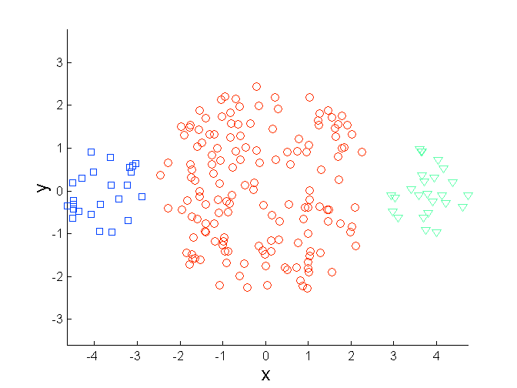
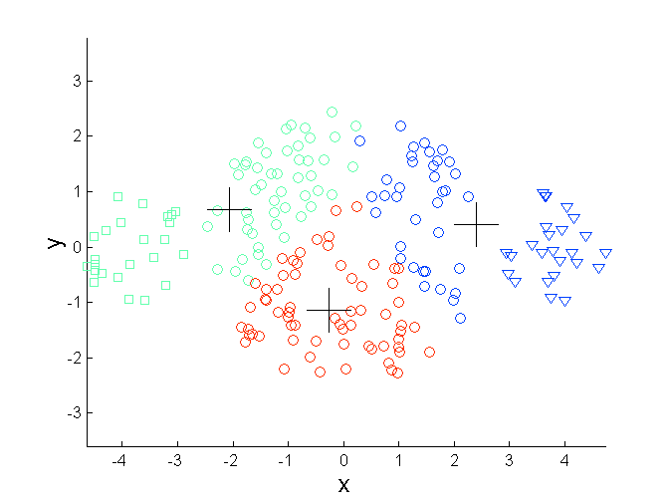
Limitations of K-means: Differing Sizes
Original Points
K-means (3 Clusters)

Slide 69
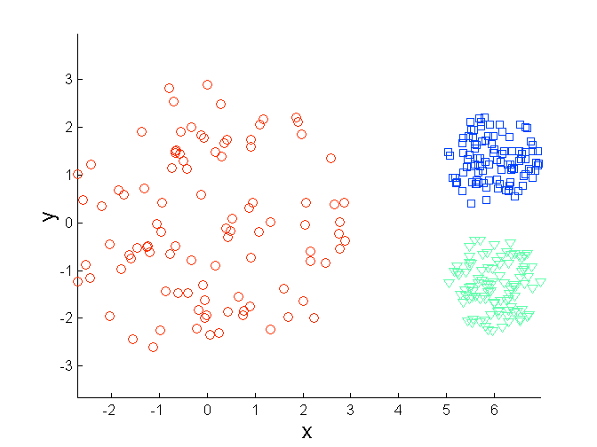
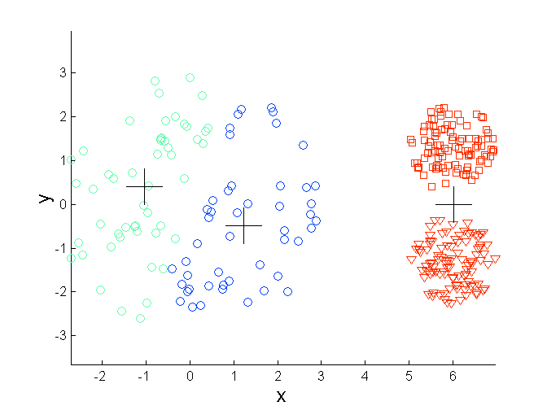
Limitations of K-means: Differing Density
Original Points
K-means (3 Clusters)

Slide 70
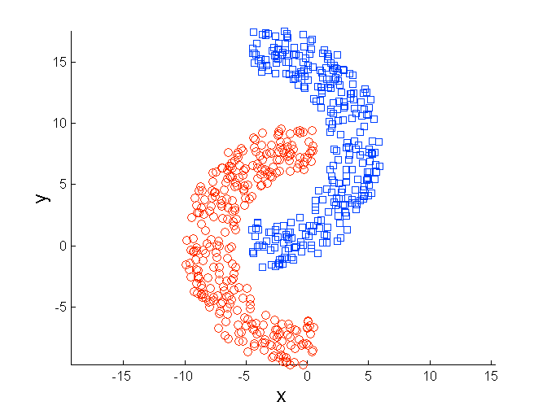
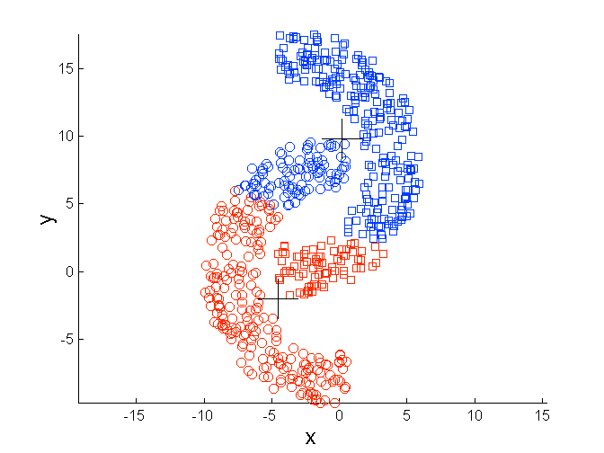
Limitations of K-means: Non-globular Shapes
Original Points
K-means (2 Clusters)

Slide 71
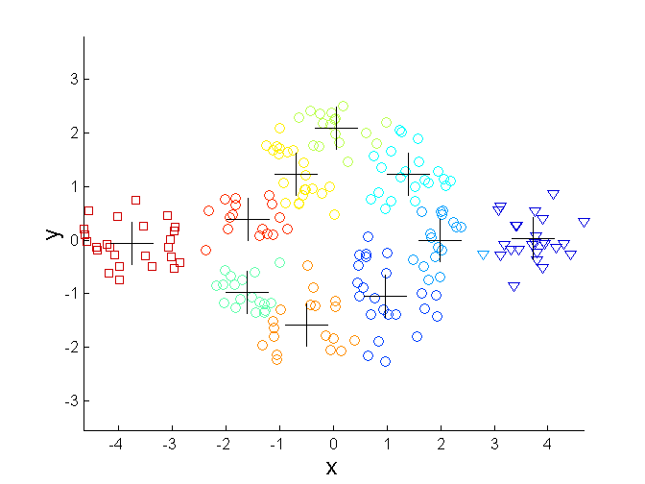
Overcoming K-means Limitations
Original Points K-means Clusters
One solution is to use many clusters.
Find parts of clusters, but need to put together.

Slide 72
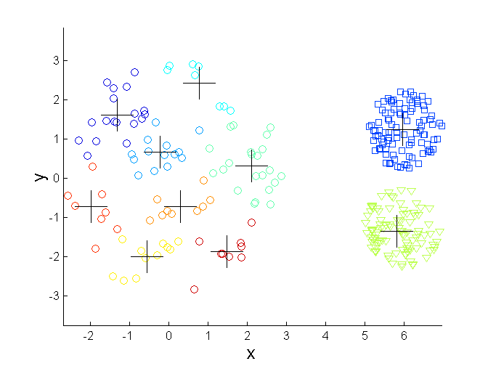
Overcoming K-means Limitations
Original Points K-means Clusters

Slide 73
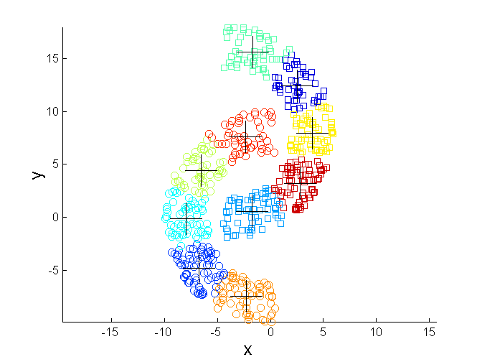
Overcoming K-means Limitations
Original Points K-means Clusters

Slide 74
2. Hierarchical Clustering
Produces a set of nested clusters organized as a hierarchical tree
Can be visualized as a dendrogram
A tree like diagram that records the sequences of merges or splits

Slide 75
Strengths of Hierarchical Clustering
Do not have to assume any particular number of clusters
Any desired number of clusters can be obtained by ‘cutting’ the dendogram at the proper level
They may correspond to meaningful taxonomies
Example in biological sciences
(e.g., animal kingdom, phylogeny reconstruction, …)

Slide 76
Hierarchical Clustering
Two main types of hierarchical clustering
Agglomerative:
Start with the points as individual clusters
At each step, merge the closest pair of clusters until only one cluster (or k clusters) left
Divisive:
Start with one, all-inclusive cluster
At each step, split a cluster until each cluster contains a point (or there are k clusters)
Similarity or distance matrix is crucial!!
Merge or split one cluster at a time

Slide 77
Agglomerative Clustering Algorithm
Basic algorithm
Compute the proximity matrix
Let each data point be a cluster
Repeat
Merge the two closest clusters
Update the proximity matrix
Until only a single cluster remains
Key operation is the computation of the similarity of two clusters
Note: Different approaches to defining the distance between clusters distinguish the different algorithms

Slide 78
Starting Situation
Start with clusters of individual points and a proximity matrix
p1
p2
p3
p4
p5
. . .
p1
p2
p3
p4
p5
.
.
.
Proximity Matrix

Slide 79
Intermediate Situation
After some merging steps, we have some clusters
C1
C2
C3
C4
C5
C1
C2
C3
C3
C4
C4
C5
Proximity Matrix
C1
C2
C5

Slide 80
Intermediate Situation
We want to merge the two closest clusters (C2 and C5) and update the proximity matrix.
C1
C2
C3
C4
C5
C1
C2
C3
C3
C4
C4
C5
Proximity Matrix
C1
C2
C5

Slide 81
After Merging
The question is “How do we update the proximity matrix?”
C2 U C5
C1
C3
C4
C1
?
C2 U C5
? ? ? ?
C3
C3
?
C4
C4
?
Proximity Matrix
C1
C2 U C5

Slide 82
How to Define Inter-Cluster Similarity
p1
p2
p3
p4
p5
. . .
p1
Similarity?
p2
p3
p4
p5
MIN
MAX
Group Average
Distance Between Centroids
Other methods driven by an objective function
Ward’s Method uses squared error
.
.
.
Proximity Matrix

Slide 83
How to Define Inter-Cluster Similarity
p1
p2
p3
p4
p5
. . .
p1
p2
p3
p4
p5
MIN
MAX
Group Average
Distance Between Centroids
Other methods driven by an objective function
Ward’s Method uses squared error
.
.
.
Proximity Matrix

Slide 84
How to Define Inter-Cluster Similarity
p1
p2
p3
p4
p5
. . .
p1
p2
p3
p4
p5
MIN
MAX
Group Average
Distance Between Centroids
Other methods driven by an objective function
Ward’s Method uses squared error
.
.
.
Proximity Matrix

Slide 85
How to Define Inter-Cluster Similarity
p1
p2
p3
p4
p5
. . .
p1
p2
p3
p4
p5
MIN
MAX
Group Average
Distance Between Centroids
Other methods driven by an objective function
Ward’s Method uses squared error
.
.
.
Proximity Matrix

Slide 86
How to Define Inter-Cluster Similarity
p1
p2
p3
p4
p5
. . .
p1
×
×
p2
p3
p4
p5
MIN
MAX
Group Average
Distance Between Centroids
Other methods driven by an objective function
Ward’s Method uses squared error
.
.
.
Proximity Matrix

Slide 87
3. Density-Based Clustering Methods
Clustering based on density (local cluster criterion), such as density-connected points
Major features:
Discover clusters of arbitrary shape
Handle noise
One scan
Need density parameters as termination condition
Several interesting studies:
DBSCAN: Ester, et al. (KDD’96)
OPTICS: Ankerst, et al (SIGMOD’99).
DENCLUE: Hinneburg & D. Keim (KDD’98)
CLIQUE: Agrawal, et al. (SIGMOD’98)

Slide 88
3. Density-based Clustering: DBSCAN
Key concepts
Density = number of points within a specified radius (Eps)
A point is a core point if it has more than a specified number of points (MinPts) within Eps [These are points that are at the interior of a cluster].
A border point has fewer than MinPts within Eps, but is in the neighborhood of a core point
A noise point is any point that is not a core point or a border point.

Slide 89
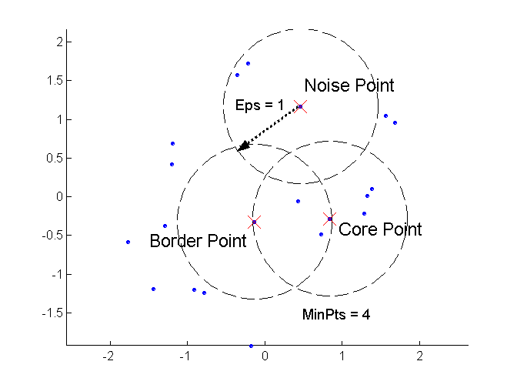
DBSCAN: Core, Border, and Noise Points

Slide 90
Two parameters:
Eps: Maximum radius of the neighbourhood
MinPts: Minimum number of points in an Eps-neighbourhood of that point
N_{Eps}(p): {q belongs to D | dist(p,q) <= Eps}
Directly density-reachable: A point p is directly density-reachable from a point q wrt. Eps, MinPts if
1) p belongs to N_{Eps}(q)
2) core point condition:
|N_{Eps} (q)| >= MinPts
p
MinPts = 5
Eps = 1 cm
q

Slide 91
Density-reachable:
A point p is density-reachable from a point q wrt. Eps, MinPts if there is a chain of points p₁, …, p_{n}, p₁ = q, p_{n} = p such that p_{i+1} is directly density-reachable from p_{i}
Density-connected
A point p is density-connected to a point q wrt. Eps, MinPts if there is a point o such that both, p and q are density-reachable from o wrt. Eps and MinPts.
p
p₁
q
p
q
o
A cluster is defined as a maximal set of density-connected points

Slide 92
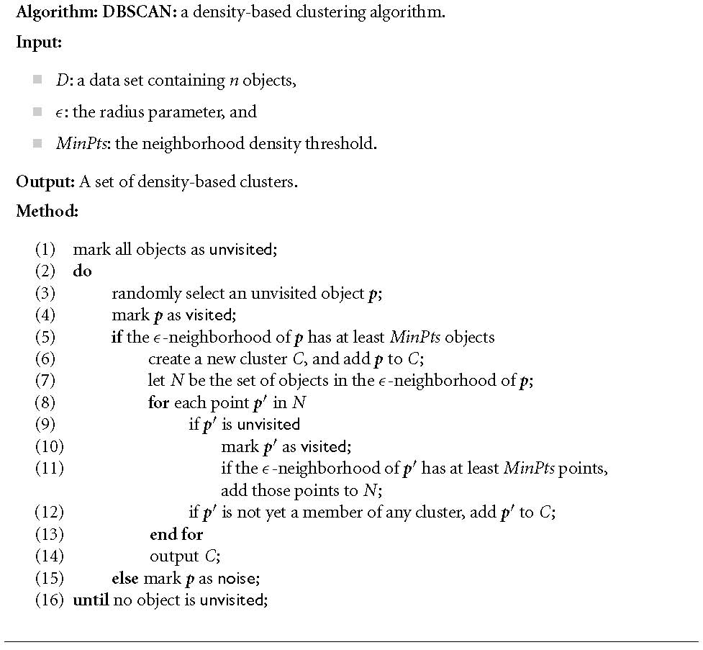
DBSCAN Algorithm

Slide 93


When DBSCAN Works Well
Original Points
Clusters
Robust to Noise
Can handle clusters of different shapes and sizes

Slide 94



When DBSCAN Does NOT Work Well
(MinPts=4, Eps=9.75).
Original Points
Varying densities
High-dimensional data
(MinPts=4, Eps=9.92)

Slide 95
Measures of Cluster Validity
Numerical measures that are applied to judge various aspects of cluster validity, are classified into the following two types.
External Index: Used to measure the extent to which cluster labels match externally supplied class labels.
Entropy, NMI, ARI
Internal Index: Used to measure the goodness of a clustering structure without respect to external information.
Sum of Squared Error (SSE)

Slide 96
Association Rule Mining

Slide 97
What Is Association Mining?
Association rule mining:
Finding frequent patterns, associations, correlations, or causal structures among sets of items or objects in transaction databases, relational databases, and other information repositories.
Frequent pattern: pattern (set of items, sequence, etc.) that occurs frequently in a database [AIS93]
Motivation: finding regularities in data
What products were often purchased together? — Beer and diapers?!
What are the subsequent purchases after buying a PC?
What kinds of DNA are sensitive to this new drug?
Can we automatically classify web documents?

Slide 98
Why Is Frequent Pattern or Association Mining Important?
Foundation for many essential data mining tasks
Association, correlation, causality
Sequential patterns, temporal or cyclic association, partial periodicity, spatial and multimedia association
Associative classification, cluster analysis, iceberg cube, fascicles (semantic data compression)
Broad applications
Basket data analysis, cross-marketing, catalog design, sale campaign analysis
Web log (click stream) analysis, DNA sequence analysis, etc.

Slide 99
Association Rule Mining
Given a set of transactions, find rules that will predict the occurrence of an item based on the occurrences of other items in the transaction
Market-Basket transactions
Example of Association Rules
{Diaper} → {Beer}, {Milk, Bread} → {Eggs,Coke}, {Beer, Bread} → {Milk},
Implication means co-occurrence, not causality!

Slide 100
Definition: Frequent Itemset
Itemset
A collection of one or more items
Example: {Milk, Bread, Diaper}
k-itemset
An itemset that contains k items
Support count (σ)
Frequency of occurrence of an itemset
E.g. σ({Milk, Bread,Diaper}) = 2
Support
Fraction of transactions that contain an itemset
E.g. s({Milk, Bread, Diaper}) = 2/5
Frequent Itemset
An itemset whose support is greater than or equal to a minsup threshold

Slide 101
Definition: Association Rule
Association Rule
An implication expression of the form X → Y, where X and Y are itemsets
Example: {Milk, Diaper} → {Beer}
Rule Evaluation Metrics
Support (s)
Fraction of transactions that contain both X and Y
Confidence (c)
Measures how often items in Y appear in transactions that contain X
Example:

Slide 102
Basic Concepts: Frequent Patterns and Association Rules
Transaction-id | Items bought
10 | A, B, C
20 | A, C
30 | A, D
40 | B, E, F
Itemset X={x₁, …, x_{k}}
Find all the rules X→Y with min confidence and support
support, s, probability that a transaction contains X∪Y
confidence, c, conditional probability that a transaction having X also contains Y.
Customer
buys both
Customer
buys diaper
Let min_support = 50%, min_conf = 50%:
A → C (50%, 66.7%)
C → A (50%, 100%)
Customer
buys beer

Slide 103
Association Rule Mining Task
Given a set of transactions T, the goal of association rule mining is to find all rules having
support ≥ minsup threshold
confidence ≥ minconf threshold
Example of Rules:
{Milk,Diaper} → {Beer} (s=0.4, c=0.67) {Milk,Beer} → {Diaper} (s=0.4, c=1.0)
{Diaper,Beer} → {Milk} (s=0.4, c=0.67)
{Beer} → {Milk,Diaper} (s=0.4, c=0.67) {Diaper} → {Milk,Beer} (s=0.4, c=0.5)
{Milk} → {Diaper,Beer} (s=0.4, c=0.5)

Slide 104
Mining Association Rules
Two-step approach:
Frequent Itemset Generation
Generate all itemsets whose support ≥ minsup
Rule Generation
Generate high confidence rules from each frequent itemset, where each rule is a binary partitioning of a frequent itemset
NOTE: Frequent itemset generation is still computationally expensive

Slide 105
Frequent Itemset Generation
Brute-force approach:
Each itemset in the lattice is a candidate frequent itemset
Count the support of each candidate by scanning the database
Match each transaction against every candidate
Complexity ~ O(NMw) => Expensive since M = 2^{d} !!!

Slide 106
Frequent Itemset Generation
Given d items, there are 2^{d} possible candidate itemsets

Slide 107
Frequent Itemset Generation Strategies
Reduce the number of candidates (M)
Complete search: M=2^{d}
Use pruning techniques to reduce M
Reduce the number of transactions (N)
Reduce the size of N as the size of itemset increases
Used by DHP and vertical-based mining algorithms
Reduce the number of comparisons (NM)
Use efficient data structures to store the candidates or transactions
No need to match every candidate against every transaction

Slide 108
Reducing Number of Candidates
Apriori principle:
If an itemset is frequent, then all of its subsets must also be frequent
If {beer, diaper, nuts} is frequent, so is {beer, diaper}
i.e., every transaction having {beer, diaper, nuts} also contains {beer, diaper}
Apriori principle holds due to the following property of the support measure:
Support of an itemset never exceeds the support of its subsets
This is known as the anti-monotone property of support

Slide 109
Illustrating Apriori Principle
Found to be Infrequent
Pruned supersets

Slide 110
Illustrating Apriori Principle
Items (1-itemsets)
Pairs (2-itemsets)
(No need to generate candidates involving Coke or Eggs)
Minimum Support = 3
Triplets (3-itemsets)
If every subset is considered,
⁶C₁ + ⁶C₂ + ⁶C₃ = 41
With support-based pruning,
6 + 6 + 1 = 13

Slide 111
The Apriori Algorithm—An Example
Sup_{min} = 2
Itemset | sup
{A} | 2
{B} | 3
{C} | 3
{D} | 1
{E} | 3
Database TDB
Itemset | sup
{A} | 2
{B} | 3
{C} | 3
{E} | 3
L₁
Tid | Items
10 | A, C, D
20 | B, C, E
30 | A, B, C, E
40 | B, E
C₁
1st scan
C₂
Itemset | sup
{A, B} | 1
{A, C} | 2
{A, E} | 1
{B, C} | 2
{B, E} | 3
{C, E} | 2
C₂
Itemset
{A, B}
{A, C}
{A, E}
{B, C}
{B, E}
{C, E}
L₂
Itemset | sup
{A, C} | 2
{B, C} | 2
{B, E} | 3
{C, E} | 2
2nd scan
C₃
Itemset
{B, C, E}
3rd scan
L₃
Itemset | sup
{B, C, E} | 2

Slide 112
The Apriori Algorithm
Pseudo-code:
C_{k}: Candidate itemset of size k
L_{k} : frequent itemset of size k
L₁ = {frequent items};
for (k = 1; L_{k} !=∅; k++) do begin
C_{k+1} = candidates generated from L_{k};
for each transaction t in database do
increment the count of all candidates in C_{k+1} that are contained in t
L_{k+1} = candidates in C_{k+1} with min_support
end
return ∪_{k} L_{k};

Slide 113
Important Details of Apriori
How to generate candidates?
Step 1: self-joining L_{k}
Step 2: pruning
How to count supports of candidates?
Example of Candidate-generation
L₃={abc, abd, acd, ace, bcd}
Self-joining: L₃*L₃
abcd from abc and abd
acde from acd and ace
Pruning:
acde is removed because ade is not in L₃
C₄={abcd}

Slide 114
Take Home Message
Basic Concepts (Supervised/unsupervised learning; Generalization)
Classification (KNN, NaïveBayes, Decision Tree, SVM, etc.)
Clustering (K-Means; Hierarchical Clustering, DBSCAN, etc.)
Association Rule Mining (Apriori, etc.)

Slide 115
Thanks !!!

